Slide 1

Team 2
BME – 673 BIO ROBOTICS
3 DOF Robotic Leg: COM trajectory planning and control
Nikhil Lokesh Chitty

Slide 2
Objectives
Kinematic and Dynamic modelling of system
Forward and Inverse kinematics of COM of the system
Trajectory planning of COM
Implementation of the trajectory on the robotic leg hardware setup

Slide 3
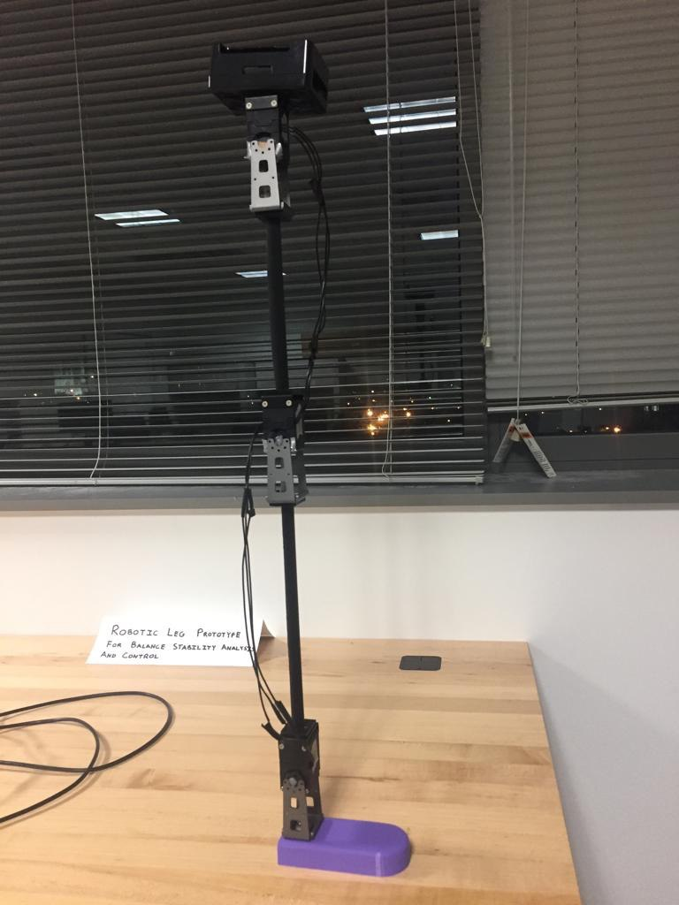
Kinematic and dynamic modelling of system
The robotic leg setup shown in the figure has to be simulated using SimScape multibody toolbox and Simulink contact forces library

Slide 4
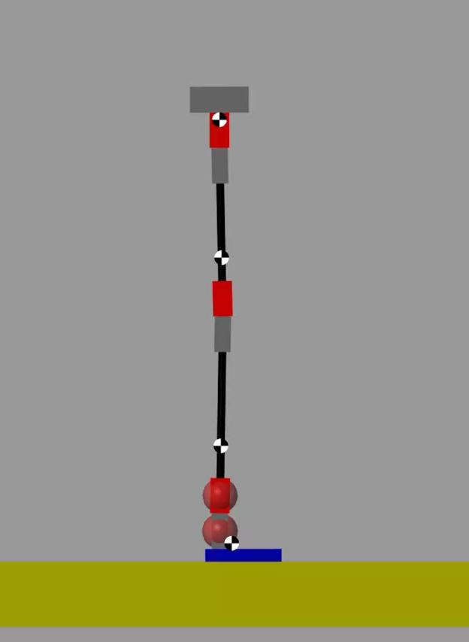
Why COM tracking ?
The Simulated robotic leg in Simulink mechanical explorer.
Unstable if not actuated such that COM position and velocity are inside a stability boundary

Slide 5


Local frame as shown, lets say {F}.
The COM of four rigid bodies seen in the image can be computed WRT {F}.
Also the COM of entire robotic leg using the four individual COM coordinates and masses WRT {F}.

Slide 6
Custom Matlab functions for position and velocity
[y,z] = COMPosition(q);
[yd,zd] = COMVelocity(q, qd);
Where q are joint angles and qd are joint angular velocities.
The above functions return the co-ordinates of COM position and the Velocity vector components of COM along Y and Z axis respectively WRT {F}

Slide 7
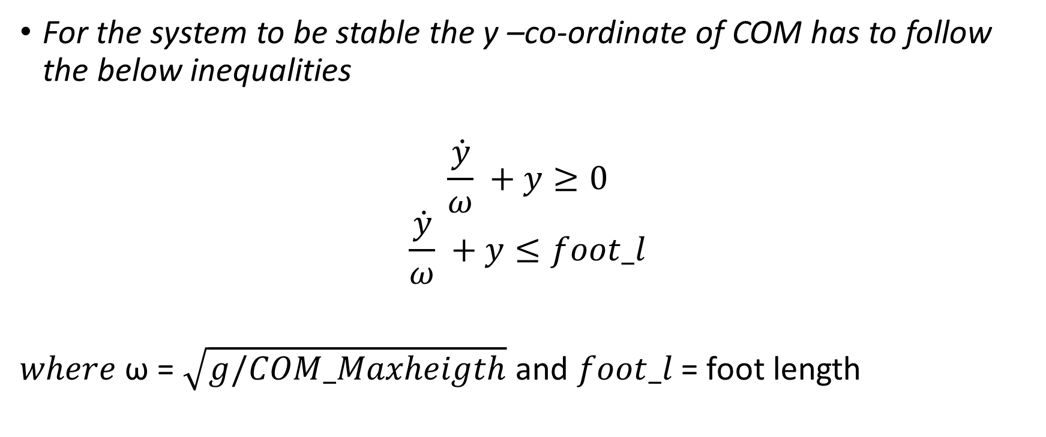
COM Stability boundaries
For the system to be stable the y –co-ordinate of COM has to follow the below inequalities
$$\frac{\dot{y}}{ω} +y≥0$$
$$\frac{\dot{y}}{ω} +y≤foot_l$$
$where$ ω = $\sqrt{g/COM_Maxheigth}$ and $foot_l$ = foot length

Slide 8
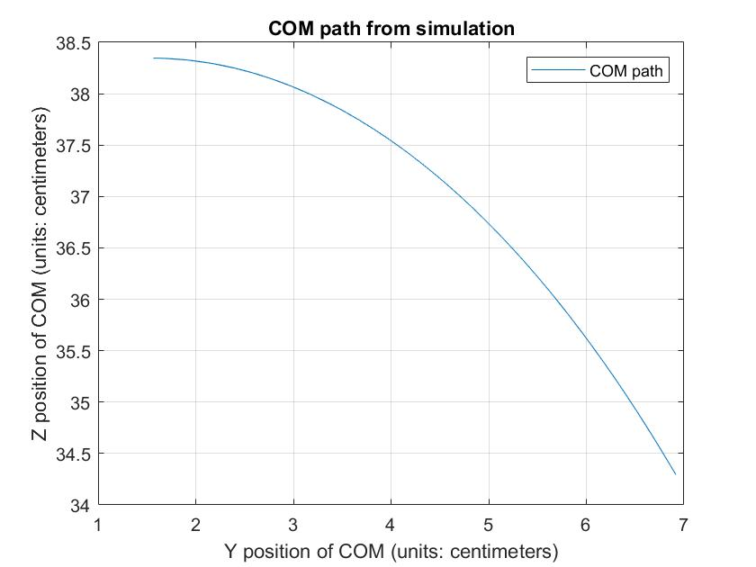
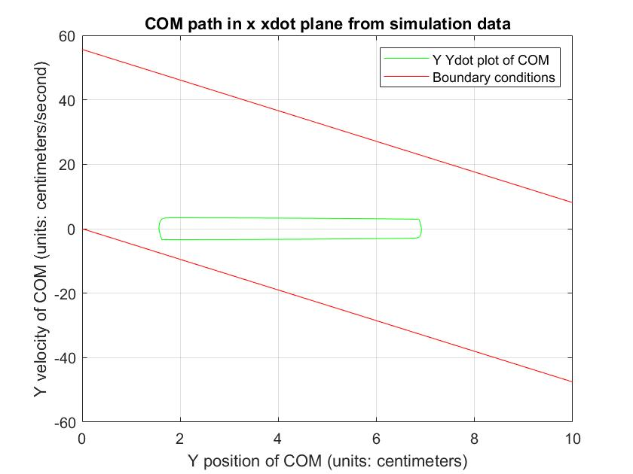
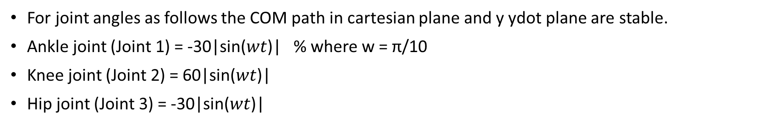
For joint angles as follows the COM path in cartesian plane and y ydot plane are stable.
Ankle joint (Joint 1) = -30|sin($wt$)| % where w = π/10
Knee joint (Joint 2) = 60|sin($wt$)|
Hip joint (Joint 3) = -30|sin($wt$)|

Slide 9
Simulink model demo and configuration steps
Robotic_leg.slx
Robotic_leg_simulation_plots.m

Slide 10
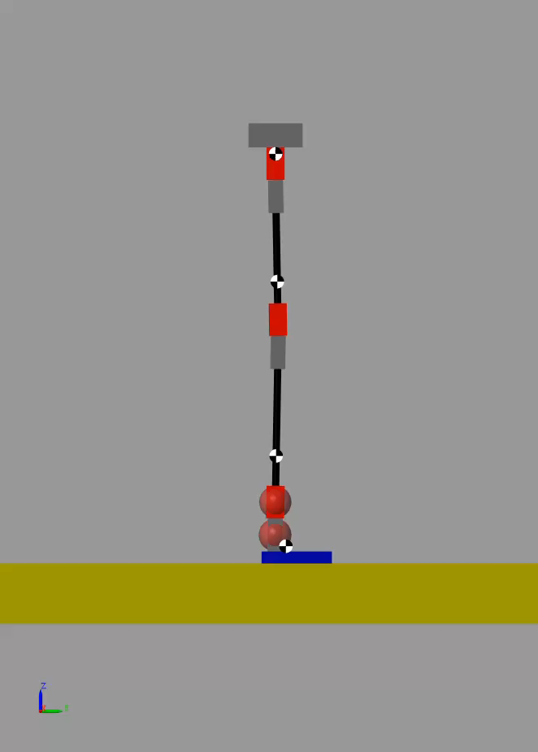
Simulation Video

Slide 11
Hardware Implementation
As the Simulation is stable, same path is implemented using the Arduino Uno, Dynamixel shield and Dynamixel motors.
Data is logged using software serial communication with a Arduino Nano and saved to a text file named “Sin_position.txt”

Slide 12
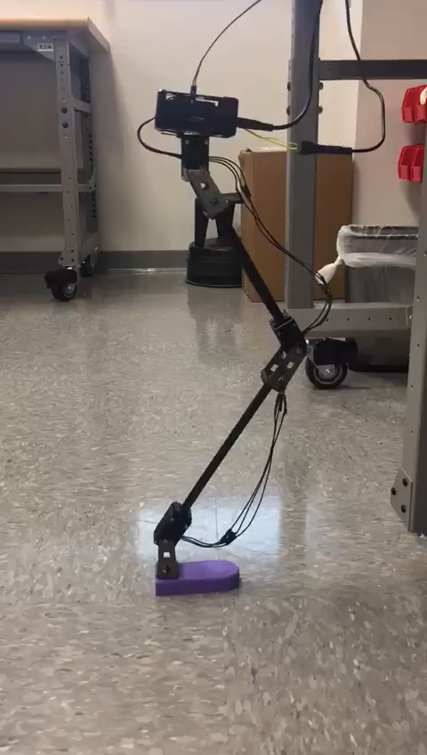
Robotic leg Video

Slide 13
Results
The logged file is read and plotted in matlab.
Edit the absolute path of the file in “file_read.m” and run the script.

Slide 14
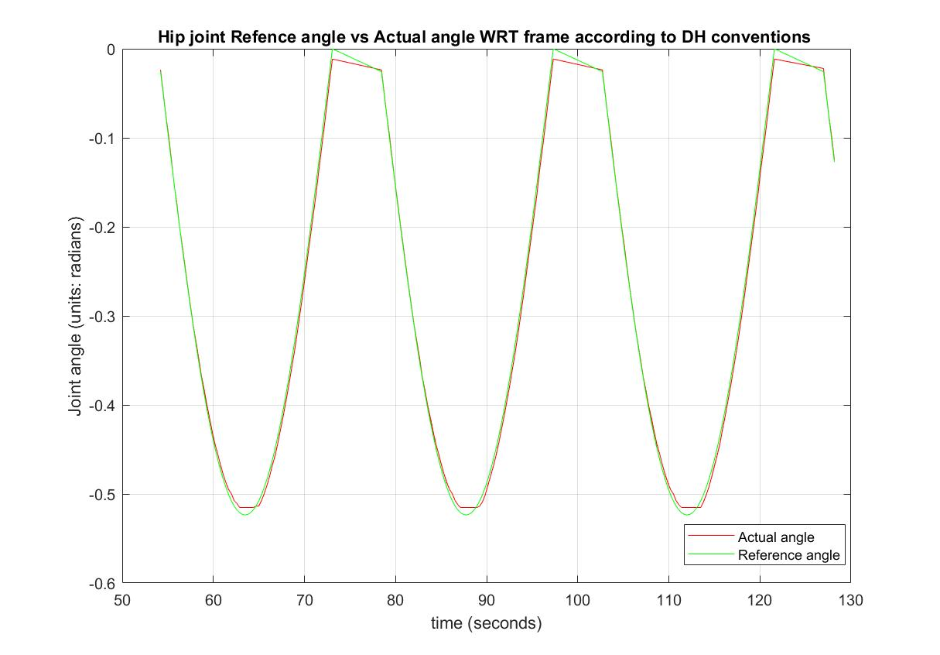
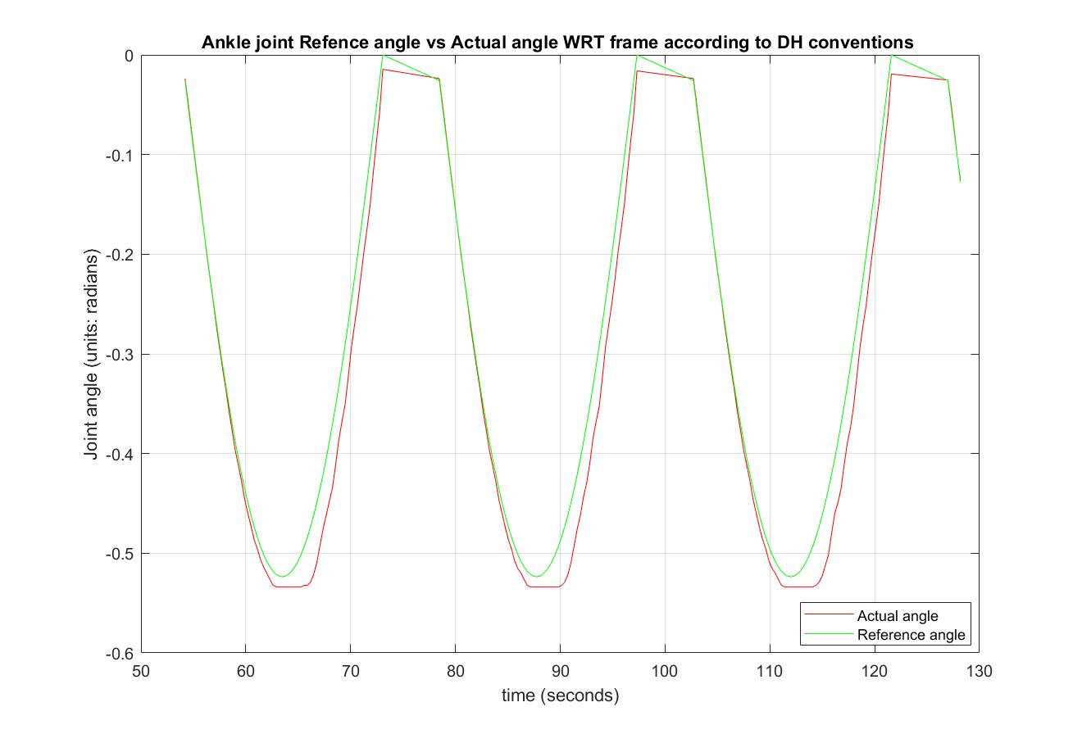
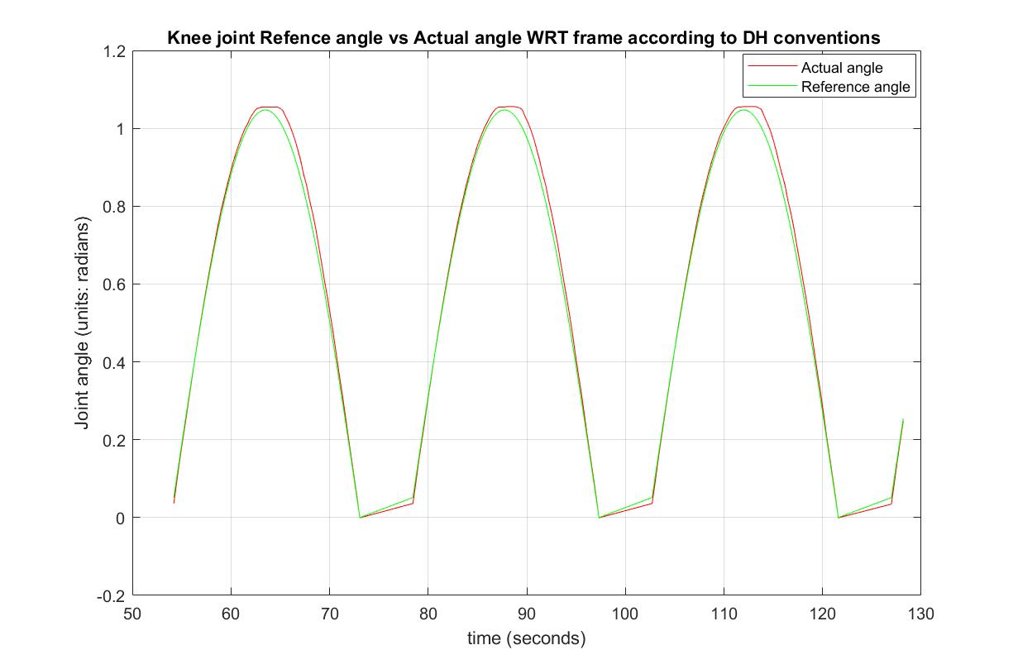
Results
From the above plots we can observe that the joint angle tracks the reference angle with a good accuracy.
The Ankle motor fails to provide enough torque for high speed implementation of the same path. (Overload LED turned ON when tested.)

Slide 15
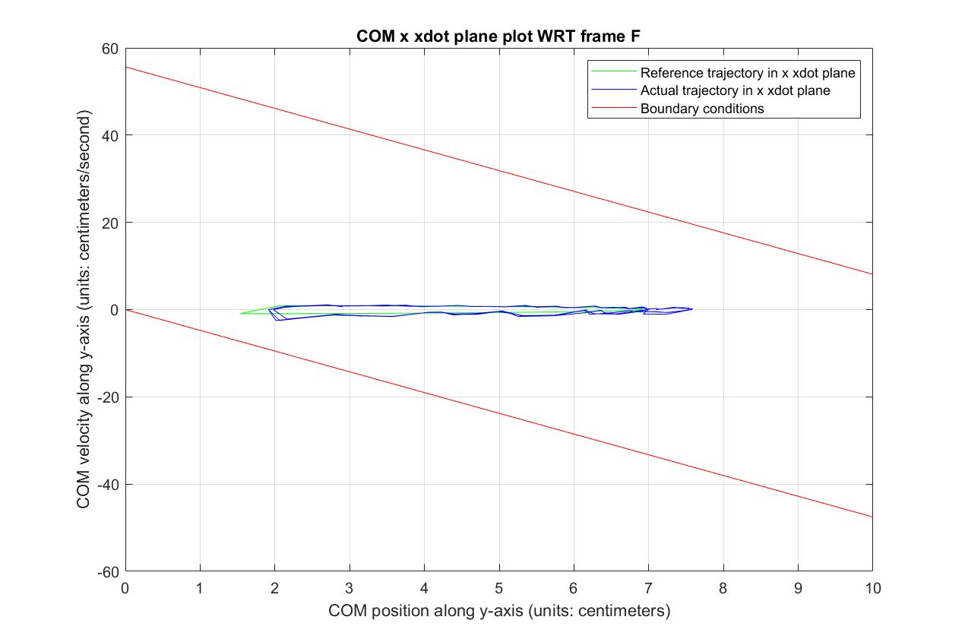
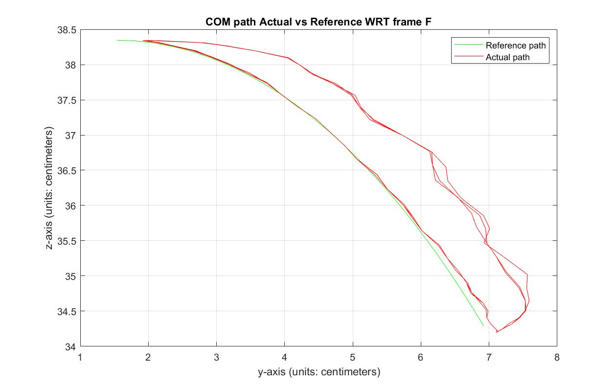
Results
From x xdot plane plot, we can infer that there is significant stable operating region. But we are operating at low velocity magnitude in this project.
From cartesian plot, The COM of the system tracks the reference COM when lowering the leg and a tracking error is observed when the leg rises up.

Slide 16
Conclusions
As highest amount of load is on Ankle motor, it is more beneficial to use a higher rated motor.
This would enable us to operate at higher speeds as well
Apart from sinusoidal reference joint angles, we can implement many other trajectories on the system and compare the performance.

Slide 17
Thank You

